Slide 1
Monday, 2/28/22
Any Questions?
Project 3
Exam 1
Module Topics
Searching & Hashing (Module 13)

Slide 2
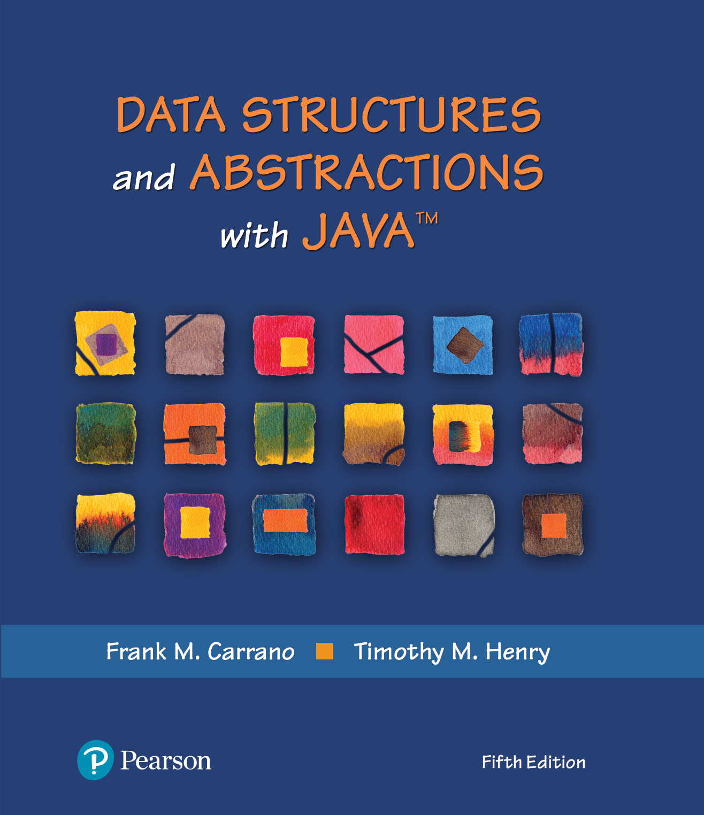
Module 13A – Searching
Chapter 19 – Searching

Slide 3
Video Notes
Searching an Array
https://mediaplayer.pearsoncmg.com/assets/secs-vn-ch19a-searching-an-array
Searching a Linked List
https://media.pearsoncmg.com/ph/esm/ecs_carrano_dsabjava_5/cw/#videonotes

Slide 4

The Problem
What search algorithms have you learned?
Notes:
What’s the most efficient way to search?
Why Dictionary is powerful

Slide 5
Sequential Search (Unsorted Array)
public static <T> boolean inArray(T[] anArray, T anEntry)
{
boolean found = false;
int index = 0;
while (!found && (index < anArray.length))
{
if (anEntry.equals(anArray[index]))
found = true;
index++;
} // end while
return found;
} // end inArray
Iterative | Using a loop to search for a specific valued entry

Slide 6
Recursive Sequential Search
/** Searches an array for anEntry. */
public static <T> boolean inArray(T[] anArray, T anEntry)
{
return search(anArray, 0, anArray.length - 1, anEntry);
} // end inArray
// Searches anArray[first] through anArray[last] for desiredItem.
// first >= 0 and < anArray.length.
// last >= 0 and < anArray.length.
private static <T> boolean search(T[] anArray, int first, int last, T desiredItem)
{
boolean found;
if (first > last)
found = false; // No elements to search
else if (desiredItem.equals(anArray[first]))
found = true;
else
found = search(anArray, first + 1, last, desiredItem);
return found;
} // end search
Method that implements this algorithm will need parameters first and last
Notes:
About the recursive routine …
private static <T> boolean search(T[] anArray, int first, int last, T desiredItem) {…}

Slide 7
Sequential Search | Efficiency
The time efficiency of a sequential search of an array
Best case O(1)
Worst case: O(n)
Average case: O(n)
Notes:
How do you determine best, worst vs. average cases?
Real life example

Slide 8

Binary Search | Sorted Array
Ignoring one half of the data when the data is sorted

Slide 9
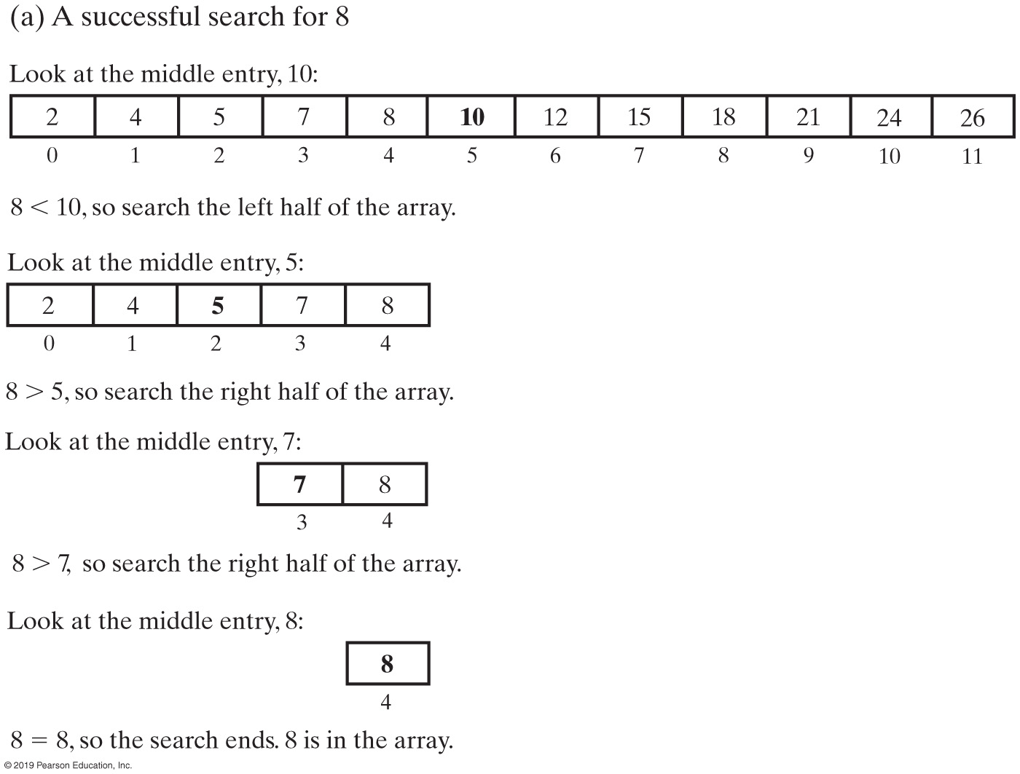
Binary Search
A recursive binary search of a sorted array

Slide 10
Binary Search
private static <T extends Comparable<? super T>>
boolean binarySearch(T[] anArray, int first, int last, T desiredItem)
{
boolean found;
int mid = first + (last - first) / 2;
if (first > last)
found = false;
else if (desiredItem.equals(anArray[mid]))
found = true;
else if (desiredItem.compareTo(anArray[mid]) < 0)
found = binarySearch(anArray, first, mid - 1, desiredItem);
else
found = binarySearch(anArray, mid + 1, last, desiredItem);
return found;
} // end binarySearch
public static <T extends Comparable<? super T>> boolean inArray(T anEntry)
{
return binarySearch(anArray, 0, anArray.length - 1, anEntry);
} // end inArray
Notes:
private static <T extends Comparable<? super T>> boolean binarySearch(T[] anArray, int first, int last, T desiredItem) {…}
Generic method

Slide 11
Generic Nomenclatures
List<? super Integer>
includes List<Integer>, List<Number> & List<Object>
https://docs.oracle.com/javase/8/docs/api/java/lang/Integer.html
// Up to the Integer class
List<? extends B> is the upper bound
List of any subclass
// B or higher
https://docs.oracle.com/javase/tutorial/extra/generics/wildcards.html

Slide 12
Efficiency of a Binary Search
Time efficiency of a binary search of an array
Best case: O(1)
Worst case: O(log n)
Average case: O(log n)
However, you must sort data first
Sorting takes time

Slide 13
Method binarySearch (Java Class Library)
/** Searches an entire array for a given item.
@param array An array sorted in ascending order.
@param desiredItem The item to be found in the array.
@return Index of the array entry that equals desiredItem;
otherwise returns –belongsAt – 1, where belongsAt is
the index of the array element that should contain desiredItem. */
public static int binarySearch(type[] array, type desiredItem);
Class Arrays
https://docs.oracle.com/javase/8/docs/api/java/util/Arrays.html
Notes:
https://docs.oracle.com/javase/8/docs/api/java/util/Arrays.html

Slide 14

Search | Unsorted Chain
A chain of linked nodes that contain the entries in a list

Slide 15
Sequential Search | Unsorted Chain
public boolean contains(T anEntry)
{
boolean found = false;
Node currentNode = firstNode;
while (!found && (currentNode != null))
{
if (anEntry.equals(currentNode.getData()))
found = true;
else
currentNode = currentNode.getNextNode();
} // end while
return found;
} // end contains
Notes:
Iteratively

Slide 16
Recursive Sequential Search (Unsorted Chain)
private boolean search(Node currentNode, T desiredItem)
{
boolean found;
if (currentNode == null)
found = false;
else if (desiredItem.equals(currentNode.getData()))
found = true;
else
found = search(currentNode.getNextNode(), desiredItem);
return found;
} // end search
public boolean contains(T anEntry)
{
return search(firstNode, anEntry);
} // end contains

Slide 17
Sequential Search (Sorted Chain)
public boolean contains(T anEntry)
{
Node currentNode = firstNode;
while ( (currentNode != null) &&
(anEntry.compareTo(currentNode.getData()) > 0) )
{
currentNode = currentNode.getNextNode();
} // end while
return (currentNode != null) &&
anEntry.equals(currentNode.getData());
} // end contains

Slide 18
Binary Search (Sorted Chain)
First find middle of the chain:
You must traverse the whole chain
Then traverse one of the halves to find the middle of that half
Conclusion
Hard to implement
Less efficient than sequential search
What can we do about it?

Slide 19
Iterative Search vs. Recursive Search
Operation | Best Case | Average Case | Worst
Sequential Search(unsorted data) | O(1) | O(n) | O(n)
Sequential Search (sorted data) | O(1) | O(n) | O(n)
Binary Search (sorted array) | O(1) | O(log n) | O(log n)
The time efficiency of searching, expressed in Big O notation

Slide 20
Iterative vs. Recursive Search
Iterative Searches
Can save some time and space
Recursive Searches
Will not require much additional space for the recursive calls
Coding binary search recursively is easier

